Slide 1

Linear regression

Slide 2
Introduction Linear Regression
It is a type of supervised machine learning algorithm
It is a statistical method that is used for predictive analysis
makes predictions for continuous/real or numeric variables such as sales, salary, age, product price, etc.

Slide 3
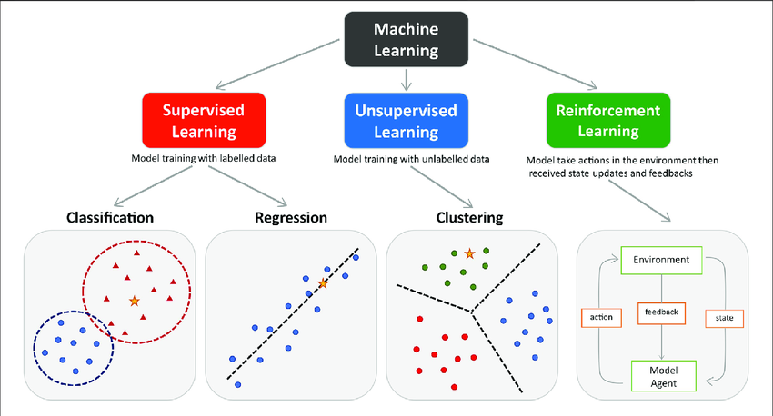
Overview of Machine Learning

Slide 4
It shows a linear relationship between a dependent and one or more independent variables
examine how the value of the dependent variable responds or varies when there are changes in the value of the independent variable
Univariate Linear regression
number of the independent feature is 1
y = β₀ + β₁x

Slide 5
Formula: y = β₀ + β₁x
y is the dependent variable (the one you want to predict)
x is the independent variable (the one you use to make predictions)
β₀ is the y-intercept (the coefficient associated with the constant or bias term)
β₁ Linear regression coefficient (slope of the line)

Slide 6
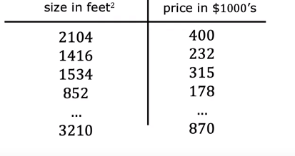
Size in feet is independent variable (x)
Price in $1000 is dependent variable(y)
X is also called feature and Y is called target variable

Slide 7
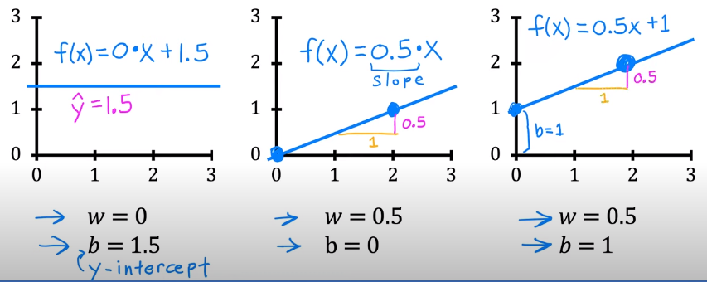
y = β₀ + β₁x
(β₀, β₁) are also called parameters
β₀= 1.5 β₁ = 0 β₀= 0 β₁ = 0 .5 β₀= 1 β₁ = 0.5

Slide 8
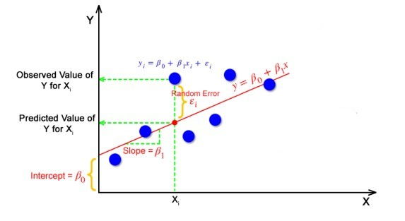

Slide 9
multivariate linear regression
If more than one feature
Formula: y = β₀ + β₁x₁ + β₂x₂ + β₃x₃ + ... + βₖxₖ
y is the dependent variable (the one you want to predict)
x is the independent variable (the one you use to make predictions)
β₀ is the y-intercept (the coefficient associated with the constant or bias term)
β₁, β₂, β₃, ..., βₖ linear regression coefficient (slope of the line)

Slide 10
Cost function for Linear Regression
The cost function or the loss function is the error or difference between the predicted value and the true value
it is the Mean Squared Error (MSE) between the predicted value and the true value

Slide 11
Formula:
MSE = (1/n) * Σ(ŷᵢ - yᵢ)²
Where:
MSE is the Mean Squared Error.
n is the number of data points.
ŷᵢ is the predicted value for the i-th data point.
yᵢ is the actual value for the i-th data point.
Σ represents the summation over all data points.

Slide 12
how to find the best-fit line in linear regression?
determine the optimal values for the coefficients (β₀ and β₁ for Linear Regression) that minimize the cost function
minimize the cost function (it is done by Gradient descent)

Slide 13
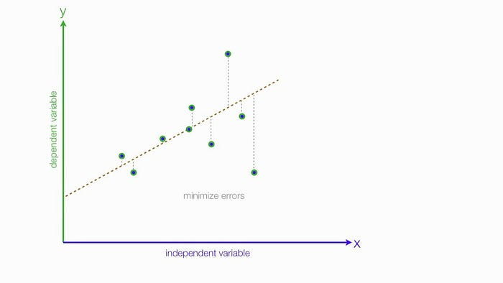

Slide 14
Gradient Descent in Linear Regression
Gradient descent is used to minimize the MSE by calculating the gradient of the cost function.
A regression model uses gradient descent to update the coefficients of the line by reducing the cost function.
It is done by a random selection of values of coefficient and then iteratively update the values to reach the minimum cost function.
A gradient is nothing but a derivative that defines the effects on outputs of the function with a little bit of variation in inputs

Slide 16
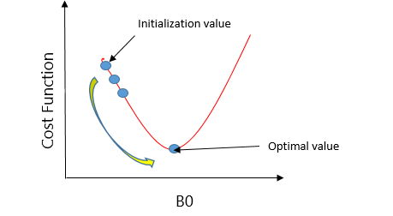

Slide 17
Model Performance Metrics
used to evaluate how well the trained linear regression model performs on new, unseen data or on a validation/test dataset
Common model performance metrics are :
R-squared (R²), Mean Squared Error (MSE), Mean Absolute Error (MAE), Root Mean Squared Error (RMSE)
These metrics provide insights into how accurately the model can generalize its predictions to real-world

Slide 18
Overfitting and Underfitting in Linear Regression
Overfitting
occurs when a model learns the training data too well and fails to generalize to unseen data
When a model gets trained with so much data, it starts learning from the noise
Also occurs due to complexity of algorithms

Slide 19
Reasons for Underfitting
The model is too simple, So it may be not capable to represent the complexities in the data
The size of the training dataset used is not enough
Features are not scaled.
Ni proper input features which is used to train the model

Slide 20
Underfitting
occurs when a model is too simple to capture the underlying relationships in the data
result in poor performance both on the training and testing data

Slide 21
Reasons for Overfitting
The model is too complex
The size of the training data

